Slide 1

“Efficient Water Heating Management System: Enhancing Comfort and Conservation with Smart Technology Integration."

Slide 2

Agenda
OBJECTIVES OF THE INVENTION
ABSTRACT
PROBLEM STATEMENT
SOLUTION
PROTOTYPE
COMPONENTS USED

Slide 3

OBJECTIVES OF THE INVENTION
1.Energy Efficiency
2. User Convenience
3.Safety and Reliability
4. Customization and Adaptability
5. Environmental Sustainability
6. Cost-Effectiveness
7. Longevity and Durability

Slide 4

ABSTRACT:
The main aim of this project presents the implementation of a cost-effective smart water heater. This framework is intended to help and give help to satisfy the needs of the elderly and the children at houses. Additionally, this idea will improve the normal living status of houses. This system is designed to avoid damage. This device is easy to install in the house with installing it, easeof use, and cost-effective design and implementation. Our main idea is to develop a system to provide people a living environment with security, comfort, environmental protection, and intelligence. We introduced a technology which willnot only save our money and time, life but will prove to be beneficial and effectivefor the economy

Slide 5
PROBLEM STATEMENT:
Despite the widespread use of water heaters in households, existing systems suffer from inefficiencies and lack user-friendly controls, resulting in unnecessary energy consumption and higher utility expenses. The absence of intelligent features and remote accessibility exacerbates these issues, leading to a suboptimal user experience and environmental strain. Thus, there is a pressing need for a sophisticated, energy-efficient solution that addresses these challenges by integrating smart technology to optimize energy usage, enhance user convenience, and promote environmental sustainability in water heating systems.

Slide 6
SOLUTION:
In this project, temperature sensors are integrated into the water heater system to monitor the temperature of the water continuously. When the water reaches a predefined temperature threshold, an alarm buzzer is activated to alert the user. This serves as a reminder for the user to turn off the heater, thus preventing overheating and reducing energy wastage.
Furthermore, the smart water heater system allows users to set their desired temperature levels, providing flexibility and customization according to individual preferences. This feature ensures optimal comfort while avoiding unnecessary heating beyond the required temperature.

Slide 7
→Overall, the smart water heater project offers an innovative solution to the common challenges associated with traditional water heaters. By incorporating Arduino technology and temperature sensors, it enables efficient energy management, enhances safety measures, and promotes user convenience, ultimately leading to reduced electricity bills and a more sustainable approach to water heating.

Slide 8
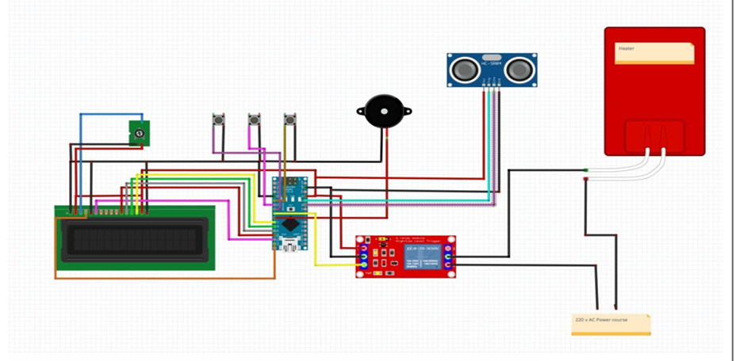
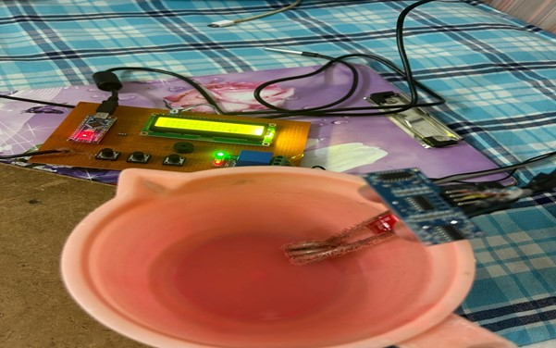
PROTOTYPE:

Slide 9

COMPONENTS USED:
ARDUINO NANO
WATER HEATER
BUZZER
DS18B20 DIGITAL TEMPARATURE
SENSOR
LCD
ULTRA SONIC SENSOR
RELAY

Slide 10
Meet our team
ANJALI
DEEPSHITHA
PRIYA
NANDINI
2203A51077
2203A51395
2203A51441
2203A51090

Slide 11


Thank you

